Slide 1
TrailBuddy
Devika Mittal, Nayeli Zurita, Kai Nguyen, Mary Zeno, Johanna Johnsen, Prapti Singh

Slide 2
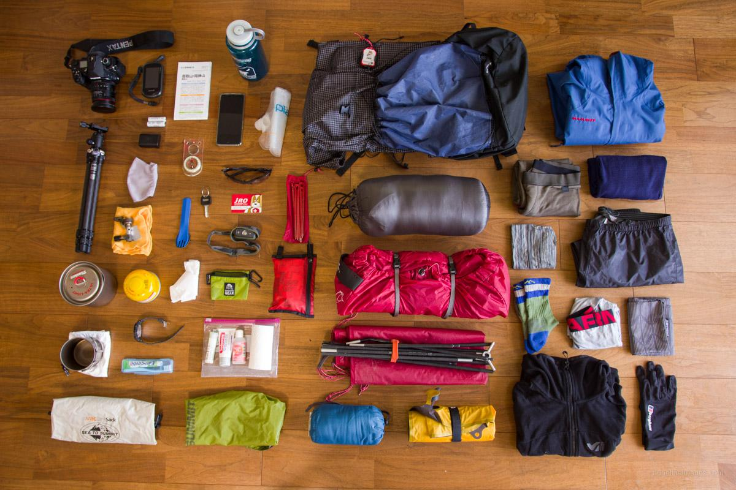
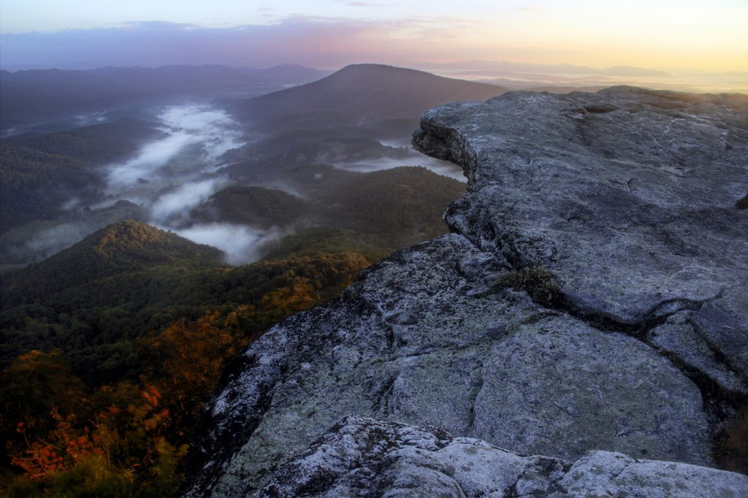

Introduction
Tedious to find trails
Preparation takes time
Difficult to find hiking group
TrailBuddy offers students a compact way to get trail information and meet new people
Notes:
devika

Slide 3
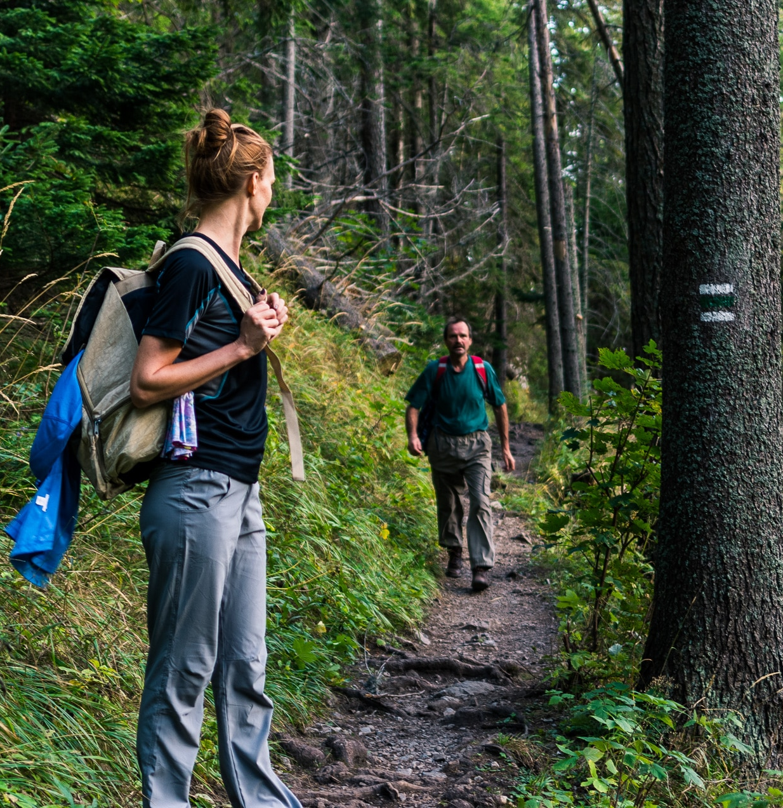
Key Features

Slide 4
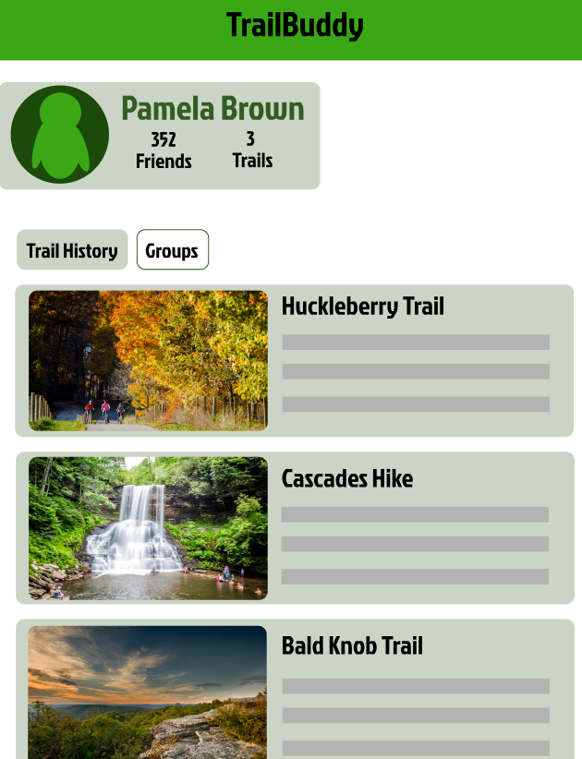
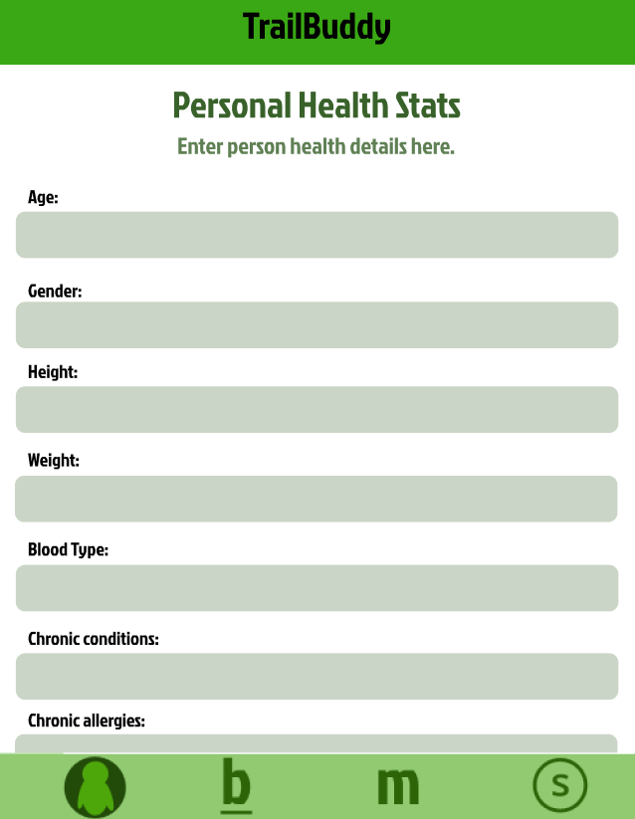
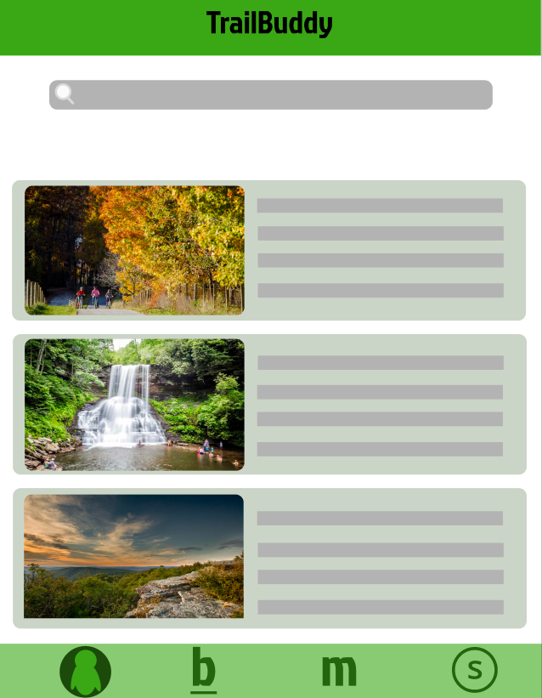
Trail Browsing
System takes user’s past trails into account
Also recommends trail based off of user conditions
Displays list of trails in user’s location
Notes:
prapti

Slide 5
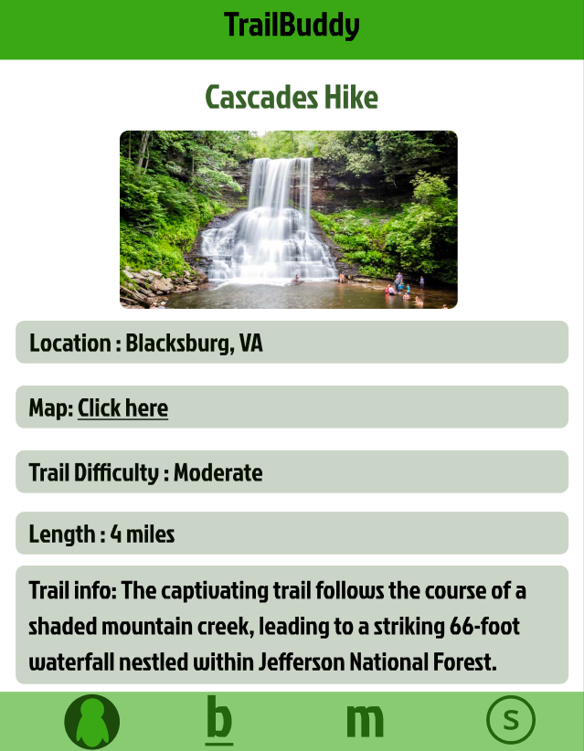
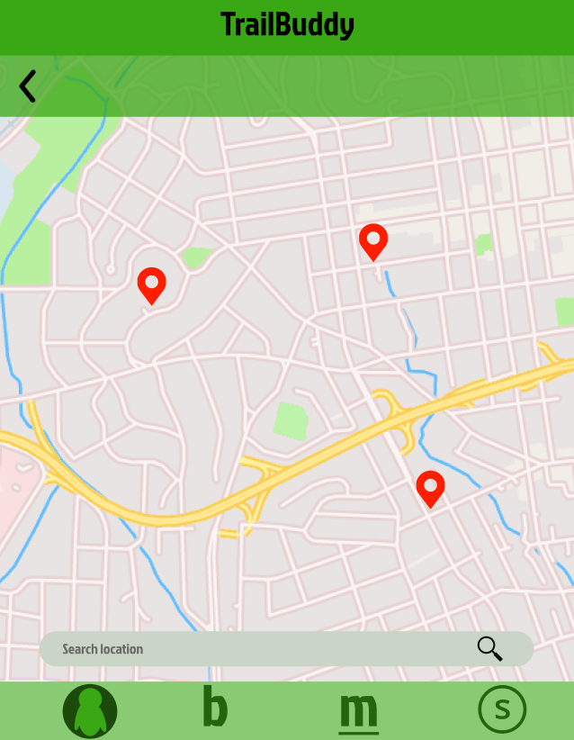
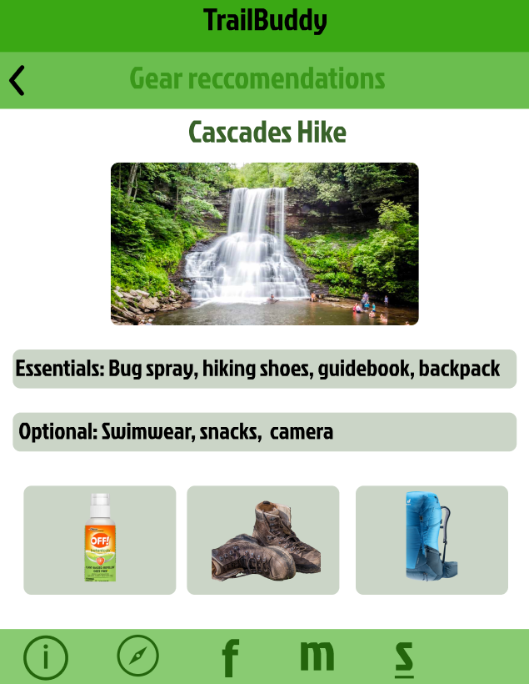
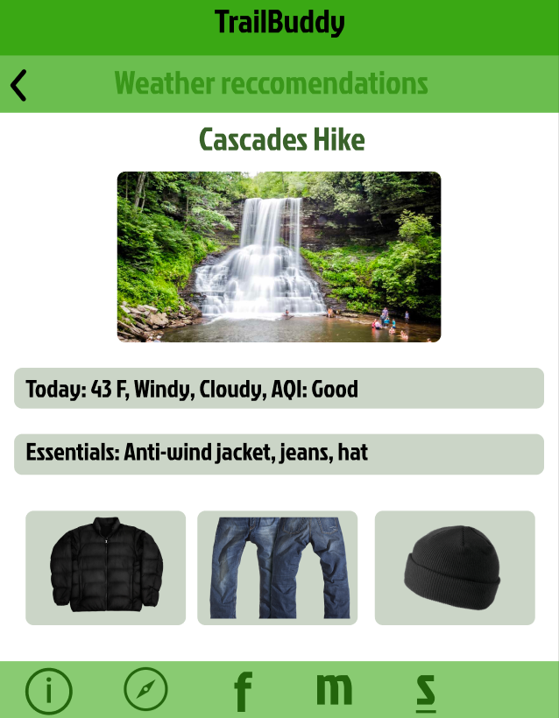
Trail Info
Brief information of trail
Trail map
Gear recommendations based off of terrain
Recommendations for weather
Notes:
kai

Slide 6
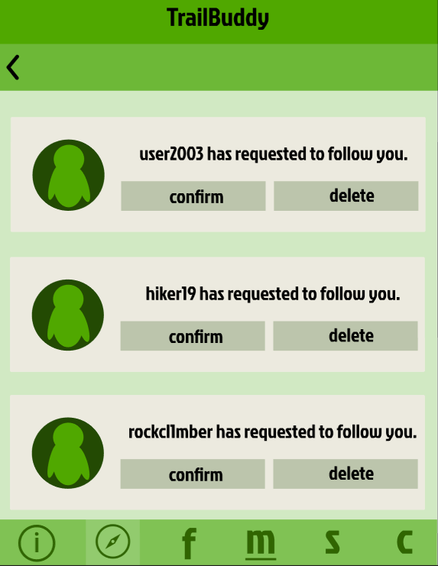
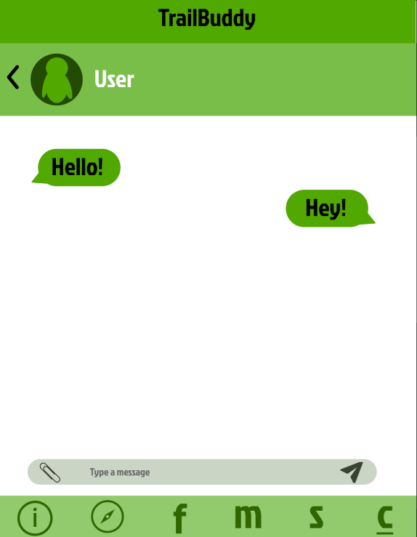
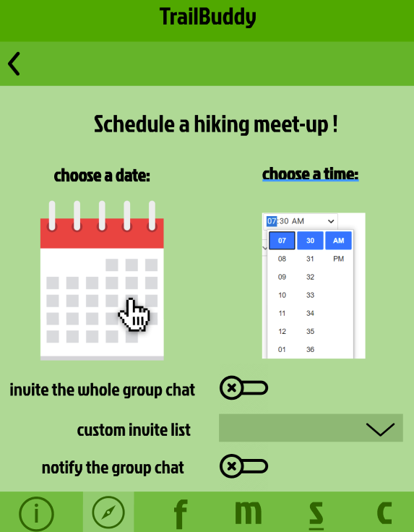
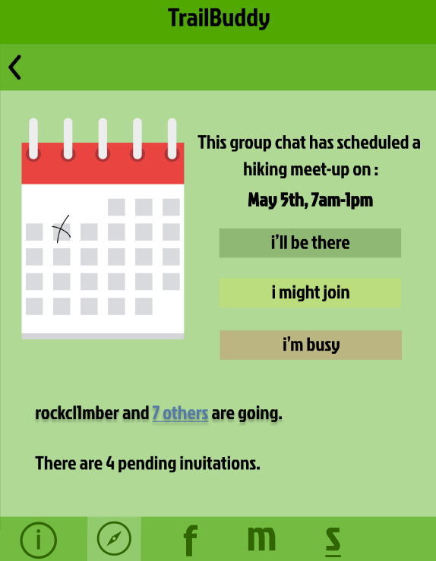
Friend & Group Matching
Friend matching
Chat feature
Meeting scheduler
Group event scheduler
Notes:
johanna

Slide 7
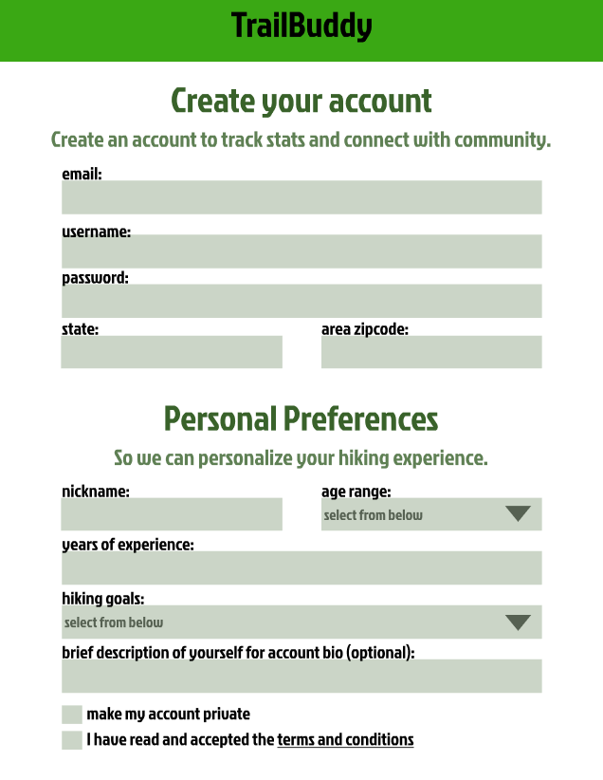
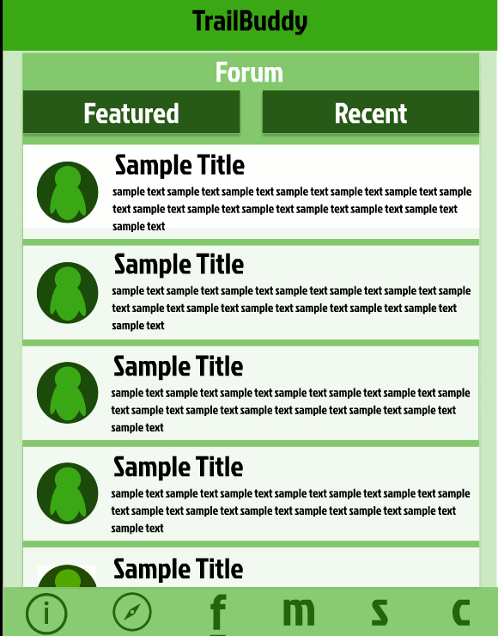
Forum
Users can discuss and share information related to hiking trails and outdoor activities, promoting community engagement.
User creates account
User customizes profile
Forum will filter to user’s interests
Notes:
Mary
One functional requirement that is included in our app is the Forum. The idea behind this is a platform for users to discuss and share information related to hiking trails and outdoor activities. This will further promote community engagement. The user can create their own account and customize their profile up to their own discretion. The forum will then filter to the unser’s own interest. Depending on the users' shared interests, they can publicly share information and discuss specific trails and activities that they found interesting. These forums are public and anyone can comment on these discussions to include their own opinions and commentary about the subject matter. If you have a last minute resort about a trail or what a more personal insight as to what a trail entails, the forum is a great place to check out. People can share their own unique experiences to people. These experiences can have a crucial impact on people’s decision about certain trails. Users can create their own thread or reply to others on pre-existing threads. Messages in the forum must be able to be subject to moderation and guidelines.

Slide 8
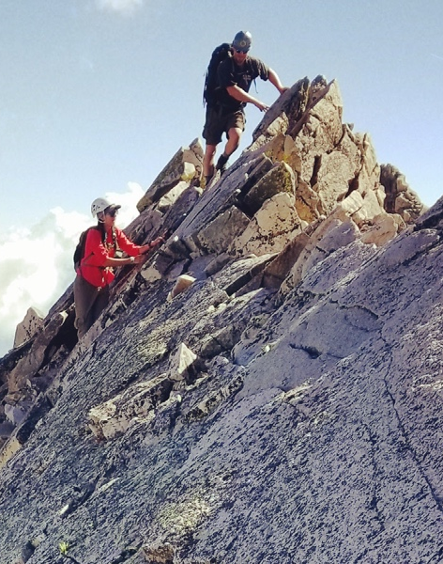
Challenges + Solutions
Notes:
Now let us move to the challenges and successes we faced when starting this project.

Slide 9



Challenges
Implementing ML algorithms to recommend trails/users
Protecting user data
Allowing friend/trail features to be independent of one another
Notes:
Mary
Now let us move to the challenges that came up while developing the design for this app.
First, we wanted to develop a smarter algorithm for recommending hikes to users. Instead of using a one dimensional weighted average approach, we wanted to implement a machine learning algorithm to give more accurate recommendations to increase user engagement. However, since this is only one feature, we wanted to balance resources with an optimal algorithm and ensure that we did not overexert resources for a single feature. That being said, it is a key aspect of the app, as it is what can determine whether a user continues with hiking. A slew of bad recommendations can easily discourage users. Determining an optimal algorithm proved difficult for these reasons outlined.
Second, is how to protect user data. In the context of a social networking app, protecting user data is paramount for users to feel comfortable sharing their data with the public. Users should also have full control over what they share, with who they share it, and be able to remove information at any time. Chats should also remain private unless extreme ethical concerns arise. User data should also not be exposed to external entities and access to user or device data should only be granted with informed user consent obtained in accordance with applicable laws. Transparency and user autonomy is highly valuable. This is a difficult task, and upholding these values poses challenges in the design.
With this privacy concern in mind, it is also important to note that some users will not want to use the social aspect of the app at all, regardless of how secure we make our app. So, we needed to make sure that we kept the social aspect of the app separate from the informational side, and that the app can function on its own without annoying users that do not want to use that side of the app. It should also be able to operate the other way, with users that want to primarily use the social aspect of the app to be able to comfortably do so.

Slide 10

Solutions: Trail Recommendation
Use collaborative filtering machine learning algorithm
Factor in user’s previous hike ratings, similarities between hikes, community hike ratings, similarities between user and specific community users, distance, and user preferences
Leverage existing open source collaborative filtering algorithms
Notes:
devika

Slide 11



Solutions: User Privacy
Allow users to make profile private
Allow users to choose who follows them
Allow users to control what they share
Keep users aware of what data is being used (location, health stats, etc)

Slide 12

Solutions: Independent Design
Make it so socializing and finding resources on hikes are not dependent on one another
Give users an option of socializing if they want to
Allow users the option to interact with the forum anonymously
Notes:
devika

Slide 13
Final Takeaways
Lessons learnt:
Prioritize user privacy and safety
Leverage new technologies for optimal algorithms
Strategic resource management
Secrets to success:
Individualize user experience as much as possible for unique and personal app engagement
Develop sense of community within the app to maximize user connection
Summary:
The app includes all the functional requirements, with an easy and effective user interaction design
Notes:
nayeli

